Slide 1
Search Engine Optimization
How to get more customers from digital marketing

Slide 2
3 Types of Traffic
When it gets down to it, there are three main
Sources for website traffic.
They are:
Traffic You Earn - Search Engine Optimization
Traffic You Buy - Pay-Per-Click/Paid Social
Traffic You Own - Email Lists

Slide 3
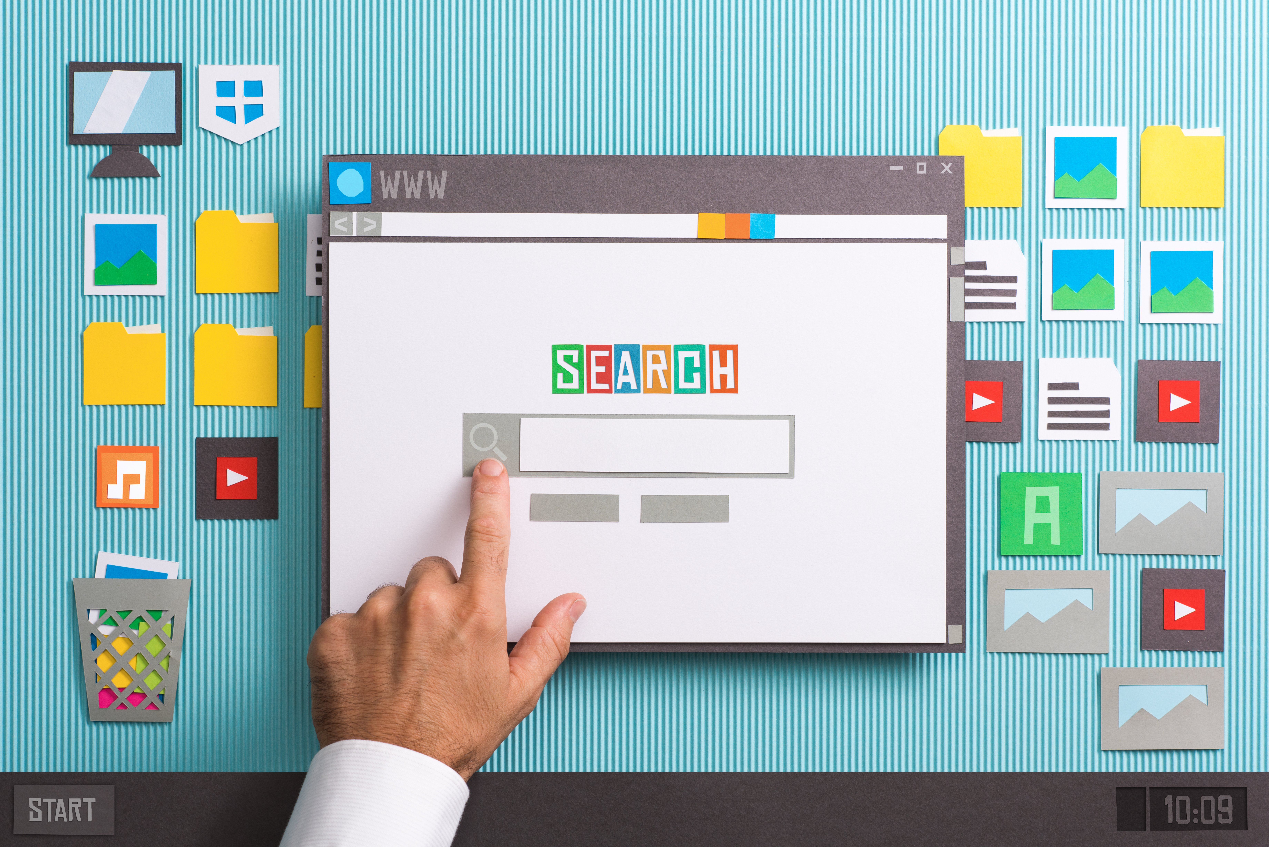
Traffic You Earn
Search Engine Optimization
Google My Business
Website SEO - On page and Off Page
Content is King!
Google Webmaster Tools
Google Analytics
Don’t forget about Bing!
Free Directory Listings - Manta, YP, MerchantCircle etc.

Slide 4
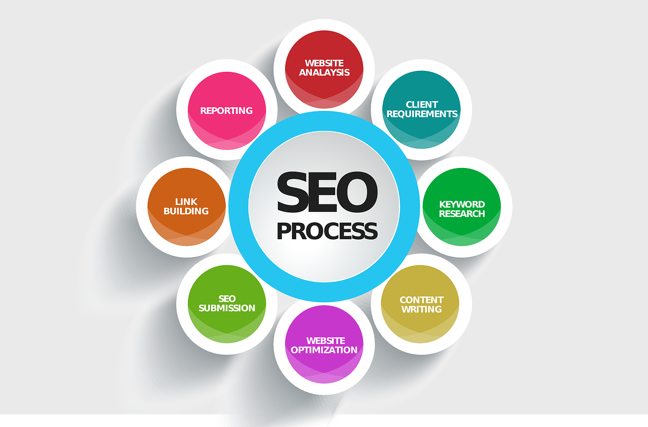
What is SEO?
SEO stands for “search engine optimization.” It is the process of getting traffic from the “free,” “organic,” “editorial” or “natural” search results on search engines.

Slide 5
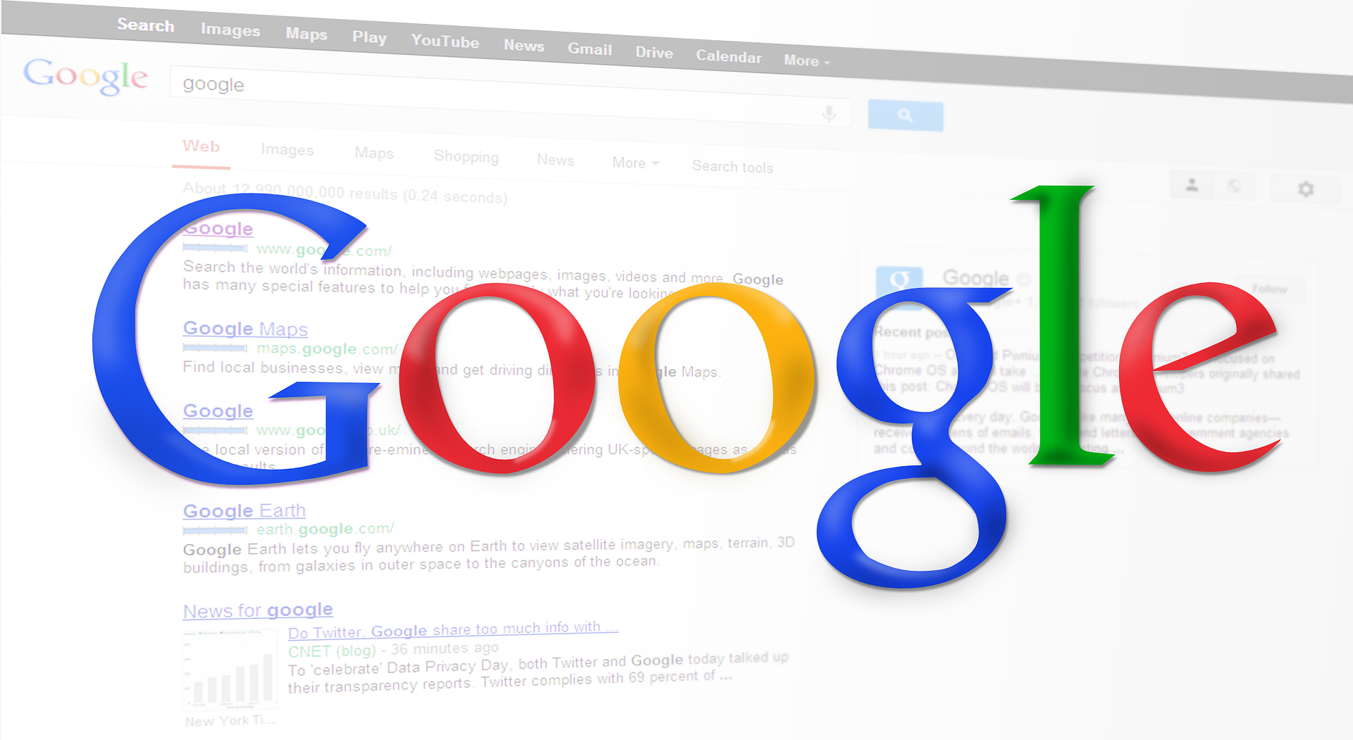
Think Like A Search Engine
Who is your potential new customer?
What will they type into the search bar to find you?

Slide 6
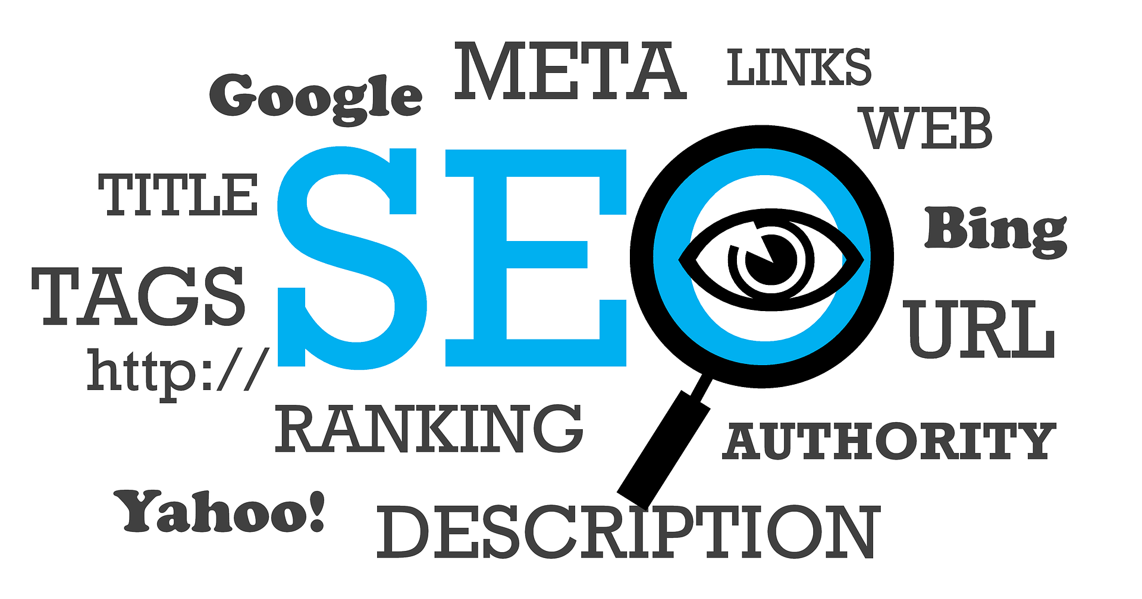
Website SEO - On page and Off Page
On-page SEO – Website optimization
This includes focus key words, meta descriptions, alt tags, SEO Titles
Off Page SEO – Optimization from other sources
This includes Backlinks, Social Media Pages, Directory Listings, Browser indexing

Slide 7
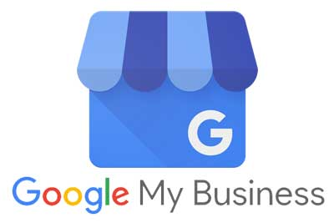
Google My Business
The most important element of any digital marketing plan is to verify and gain control of your Google My Business Page.
Just search for your business in Google Maps – and claim the page.

Slide 8
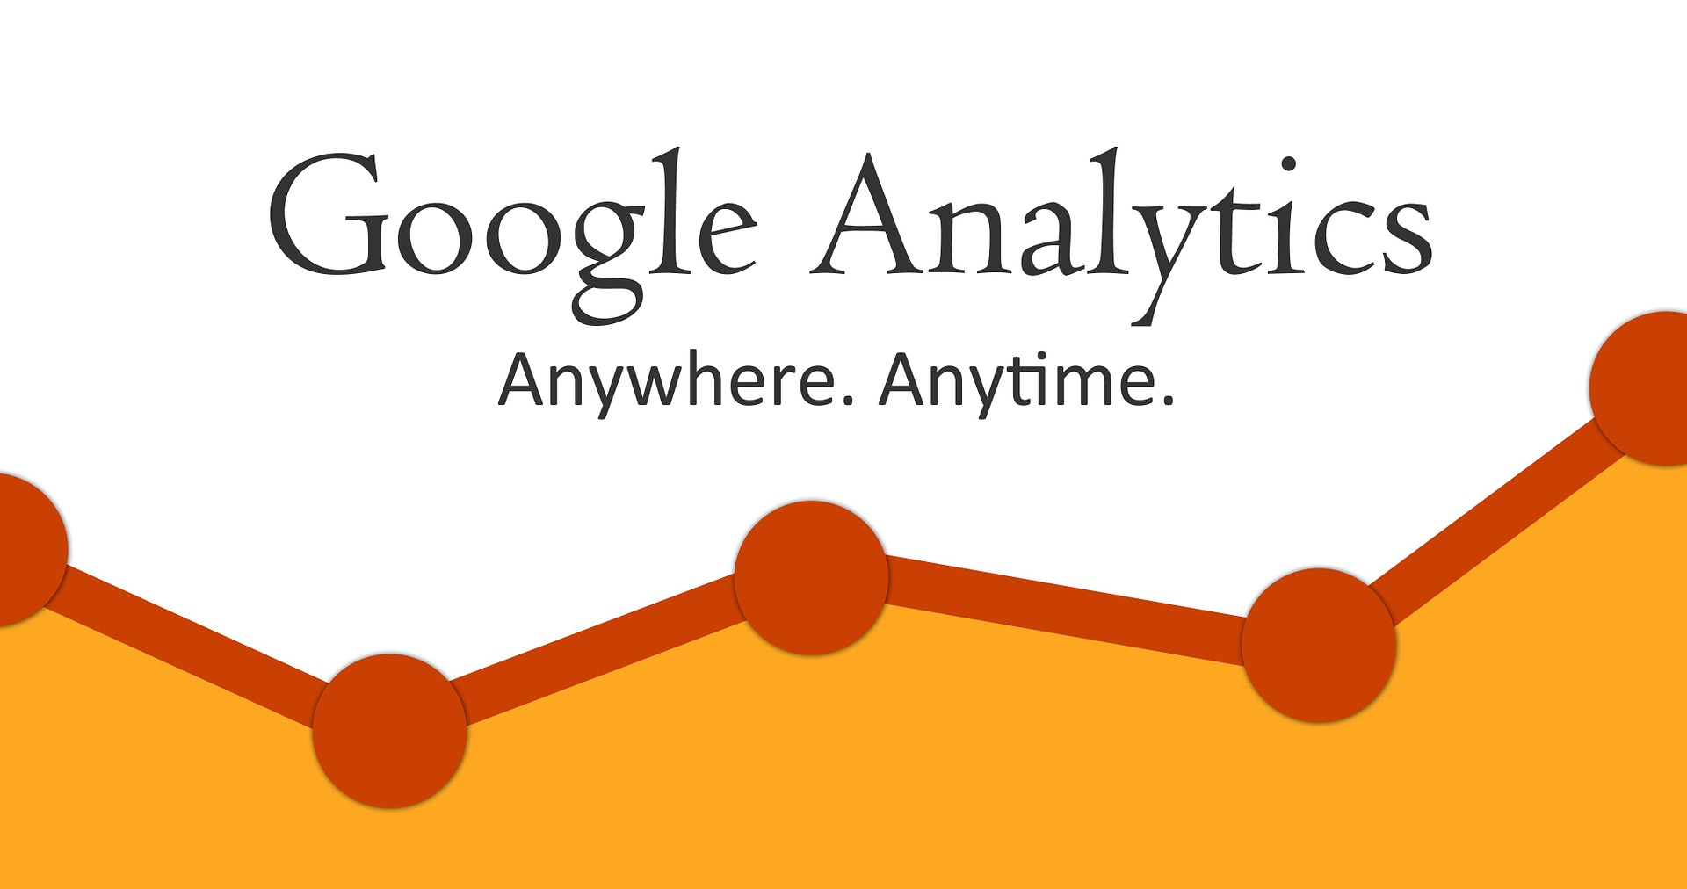
Google Analytics
Google Analytics helps you analyze visitor traffic and paints a complete picture of your audience and their needs, wherever they are along the path to becoming a customer. Submit your web address to Google Analytics to gain crucial insights into your visitors’ patterns. Once your site is verified, you will start seeing statistics about your users such as age, gender, location, etc.
The In-Page Analytics tools lets you make a visual assessment of how visitors interact with your pages. You can learn what they're looking for and what they like, then use that information to tailor all your marketing activities for maximum impact.

Slide 9
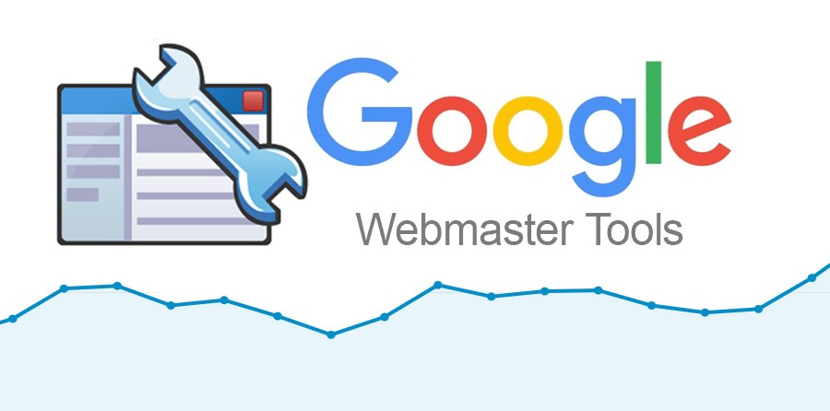
Google Webmaster Tools
This will Check for design flaws and errors such as 404′s or 302′s. Being registered with Google Webmaster Tools has other benefits as well. You will be able to evaluate and improve your site’s performance in Google Search.
You don’t have to sign up for Webmaster Tools for your site to be included in Google's search results, but doing so can help you understand how Google views your site and optimize its performance in search results.

Slide 10
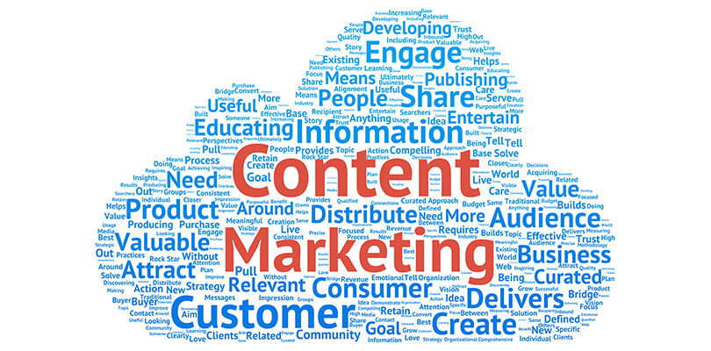
Content is King!
Providing interesting content that people actually want to read is the key to getting people coming back to your blog, or better yet, subscribing to your RSS feed so that they are notified whenever you add new content to your website.

Slide 11
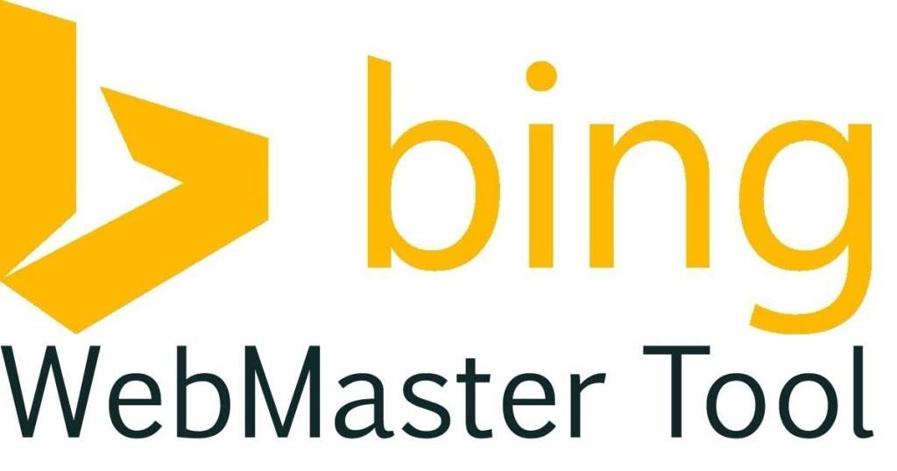
Don’t Forget About Bing!
Although Google makes up over 90% of US search queries, don’t forget to register your site with Bing Webmaster Tools. The process is very similar to Google’s, and it will get you showing up quicker and more accurately in Bing’s Search Engine Results.

Slide 12
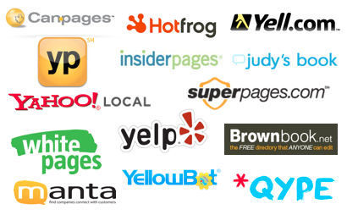
Free Directory Listings
There are many websites that will already have a profile for your business. Find these pages and claim them. You do not need to buy pro accounts (unless you really want to) but you should make sure you are in control of the content on these sites. Make sure to add your website, relevant content, and images to these free listings.

Slide 13
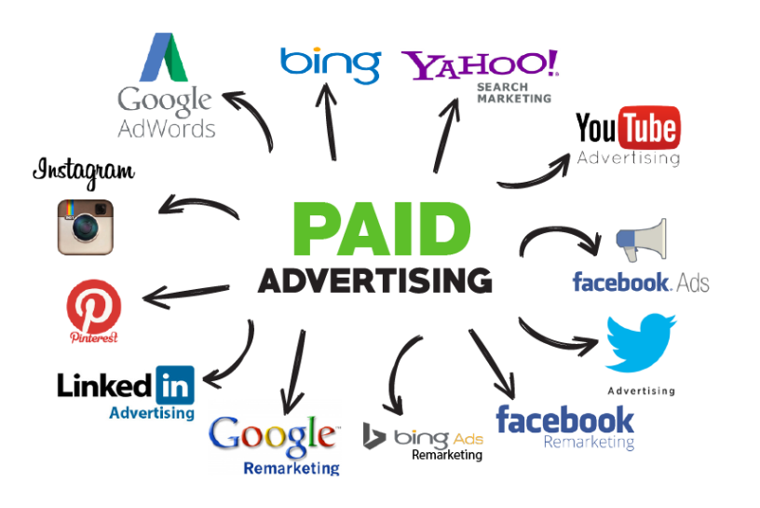
Traffic You Buy
Google PPC
Pixels and Retargeting
Facebook Ads & Instagram Ads
Twitter Ads
Pinterest Ads

Slide 14
Google Ads – Pay Per Click Marketing
Google Ads is an online advertising service developed by Google, where advertisers pay to display brief advertisements, service offerings, product listings, and video content within the Google ad network to web users. Google Ad's system is based partly on cookies and partly on keywords determined by advertisers.

Slide 15
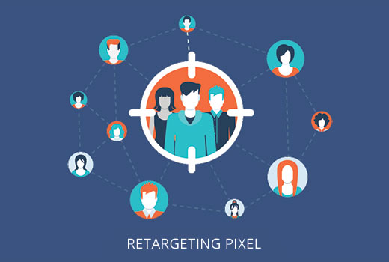
Pixels & Retargeting
Retargeting is a cookie-based technology that uses simple Javascript code to anonymously 'follow' your audience all over the Web. Here's how it works: you place a small, unobtrusive piece of code on your website (this code is sometimes referred to as a pixel).

Slide 16
Facebook & Instagram
Facebook Business Manager is a tool to help you create, publish, monitor, and report on various business-related assets, including your business's Facebook Pages, or your Facebook advertisements. Facebook business manager allows you to create pixels which allow you to retarget your customers on Facebook and Instagram.

Slide 17
Twitter Ads
Twitter also has a great retargeting option through their business manager. Unlike Facebook, you must use their business manager to boost any tweet. Twitter often gets overlooked… but there are millions of users there and the cost to advertise tends to be much cheaper then Facebook or Google.

Slide 18
Pinterest Ads
Pinterest ads are part of the native experience and look like regular Pins, only you pay to have them seen by more people. You can choose from our marketing solutions to align with your business goals. ... When someone saves your Promoted Pin, their Pinterest followers will also see your ad in their feeds. You must be set up as a verified business on Pinterest to access these ads.

Slide 19
Traffic You Own
Getting your message to your current customers
Growing your email List
The Importance of an Automated Email Funnel

Slide 20
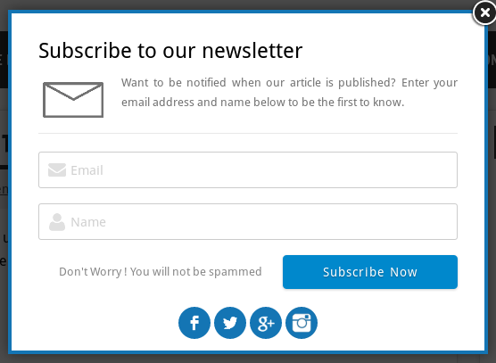
Growing your email List
An email list is a collection of email addresses that a business can create by engaging with potential customers through lead-generating campaigns. Email lists can shrink as members opt out of email subscriptions, and grow as the business solicits contact information from website visitors.

Slide 21
Get Your Message to Your Customers
20% of your customers represent 80% of your sales.
Make sure you are always selling to people who subscribe and follow

Slide 22
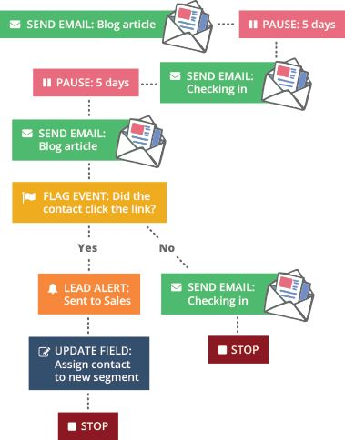
Automated Email Funnel
An email funnel is an automated chain of email marketing messages which guide a lead towards a desired action – in a non invasive way. Your users are sent emails based on the time they originally subscribed.

Slide 23
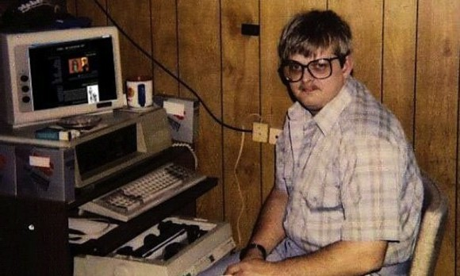
Action Steps
What to do Right Now!
Claim your Google Listing
Set Up Google Analytics
Move your Facebook page to Facebook Business Manager

Slide 24
Be Ready to Pivot
Just like fashion - digital marketing is an industry that never stops changing! Be ready to jump into the next big thing!

